Slide 1

Welcome back to ICT!
2025
Lesson 1

Slide 2

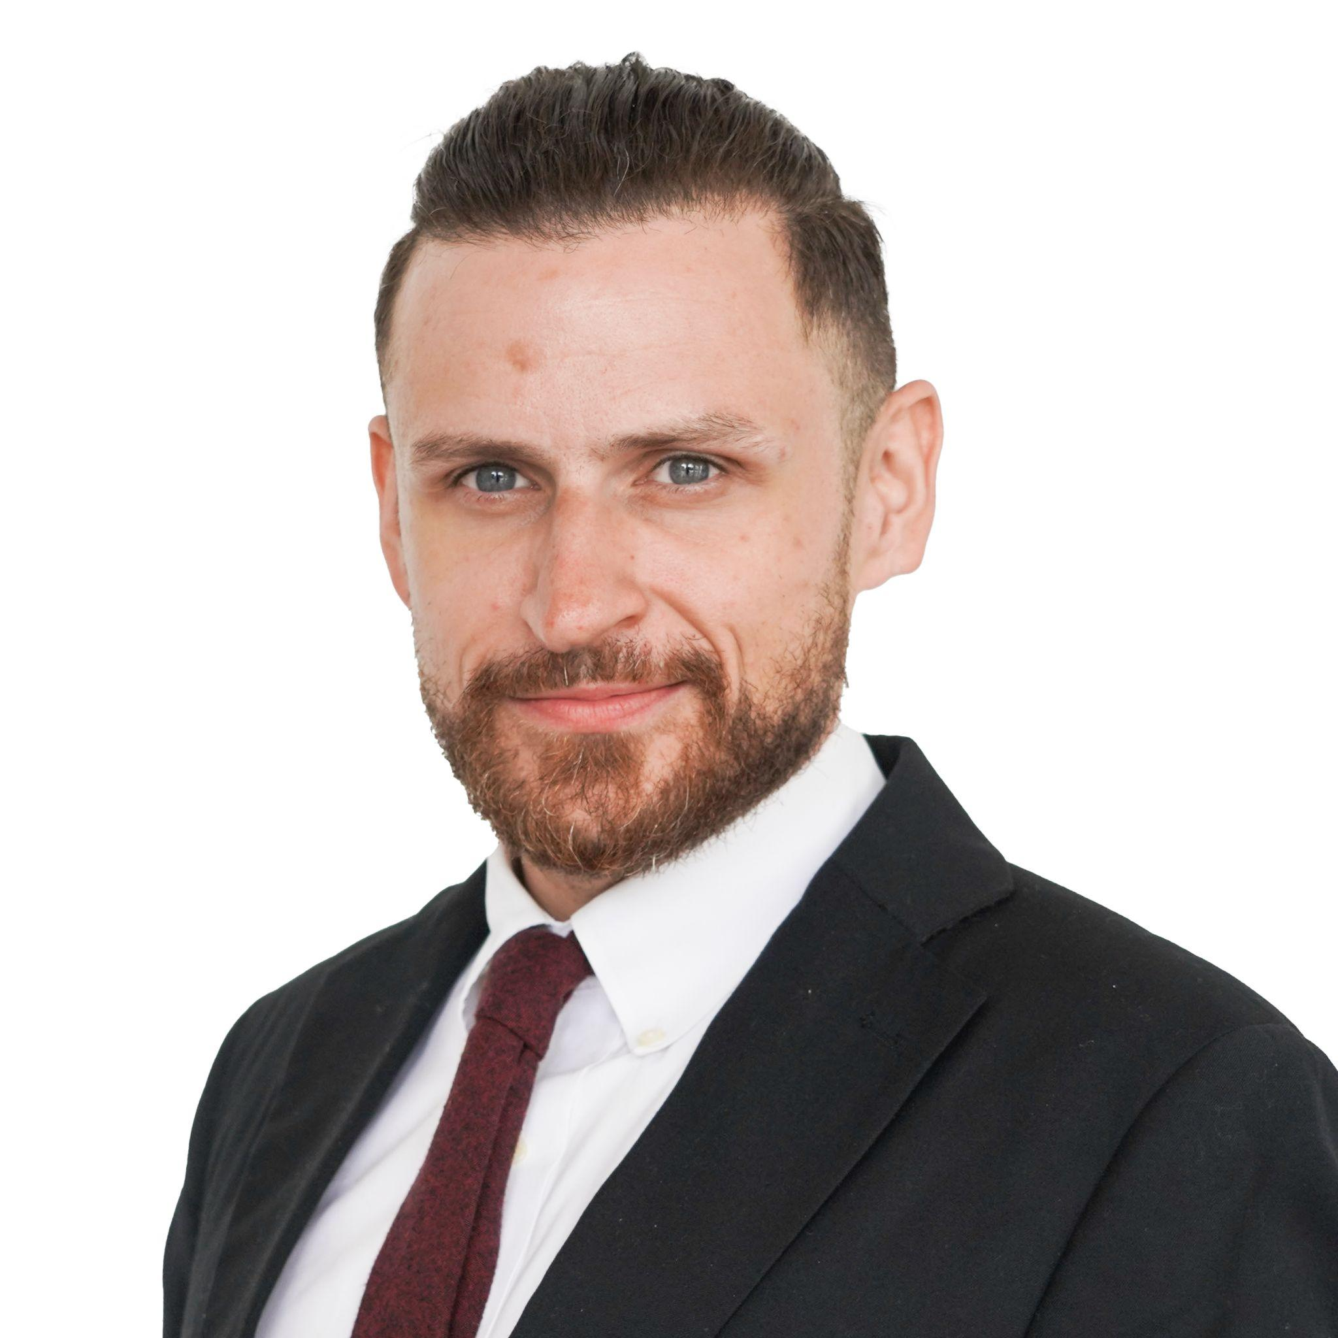
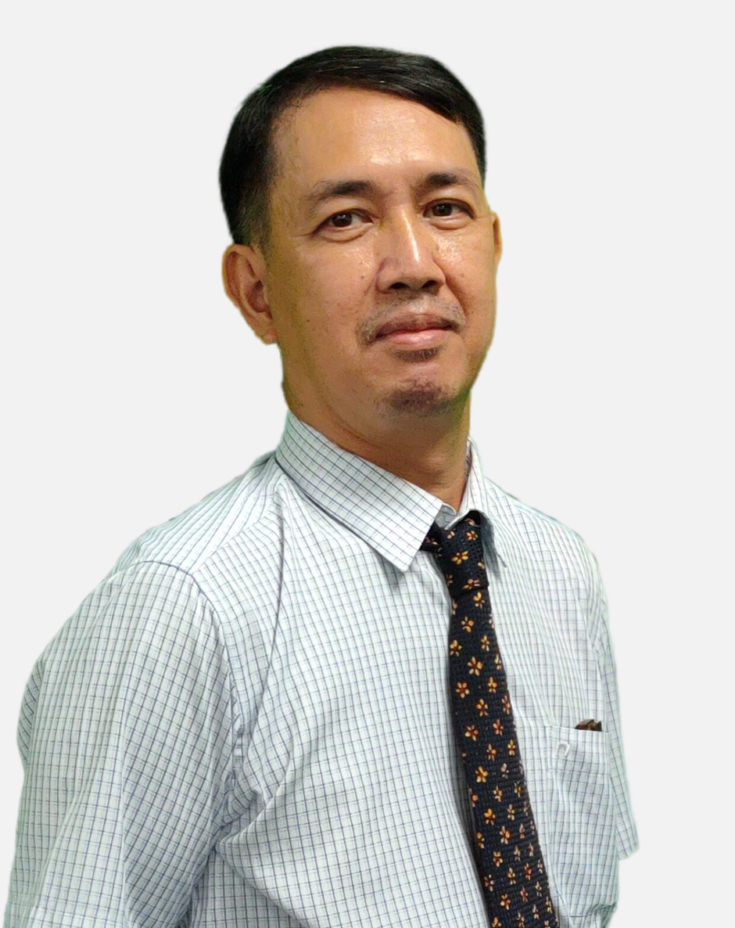
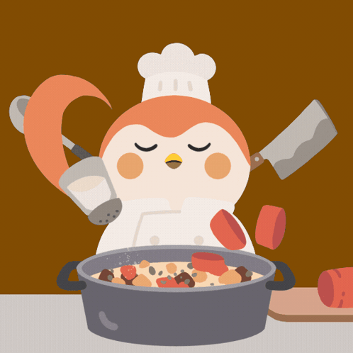




Who are we?
Mr Tue
Mr Patrick

Slide 3
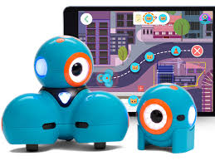
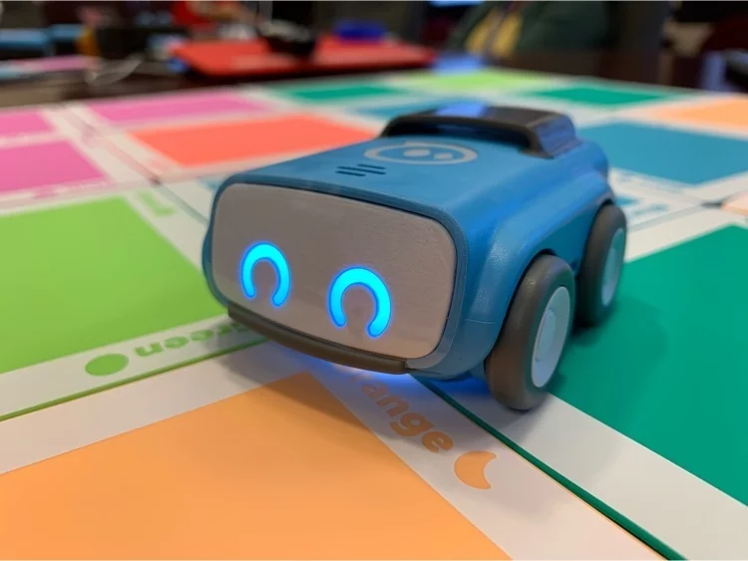
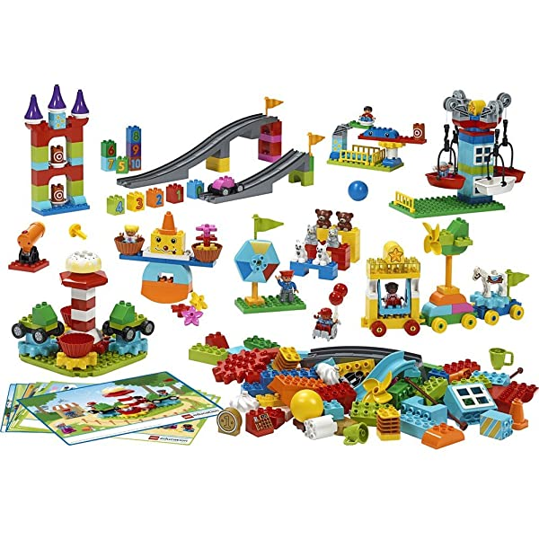

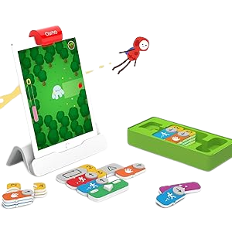
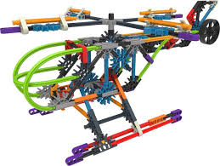
Exciting learning this year!

Slide 4

What do these look like in the DREAMS
Lab?

Slide 5
ICT
Expectations
Game
Hmm what should I do?

Slide 6
If…then…
…I should wait quietly against the wall.
…I should speak loudly to my friends.
If I am waiting outside for my teacher, then….
Notes:
Can stand up and go to the green wall or window or just point to the corner… depends on energy of class

Slide 7
If…then…
…. C3 B4 Me
(ask 3 friends for help before asking your ICT Teacher)
…. Go straight to
my teacher
for help
If I am stuck and I don’t know what to do next, then….

Slide 8
If…then…
…. I should run around the DREAMs Lab
…I should take a break and ask my teacher if I can drink water outside.
If I am in the yellow zone and feeling silly, then….
Notes:
Can stand up and go to the corner, nominate one person from each table to go to the corner or just point to the corner… depends on energy of class

Slide 9

What do we use this app for?
How do I login?

Slide 10
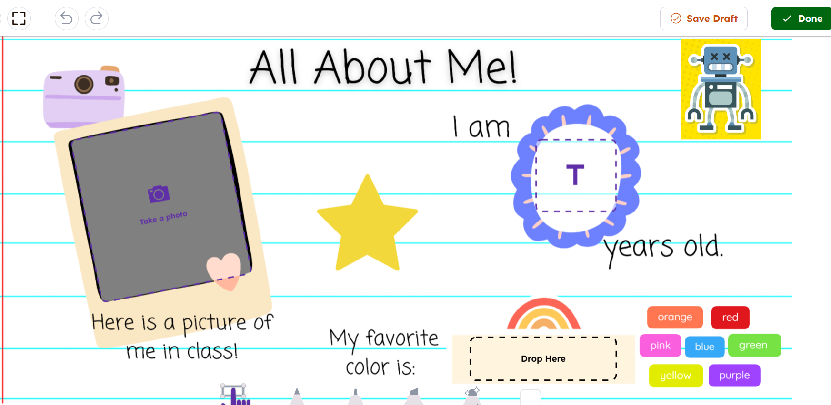
Year 1
Notes:
Seesaw

Slide 11
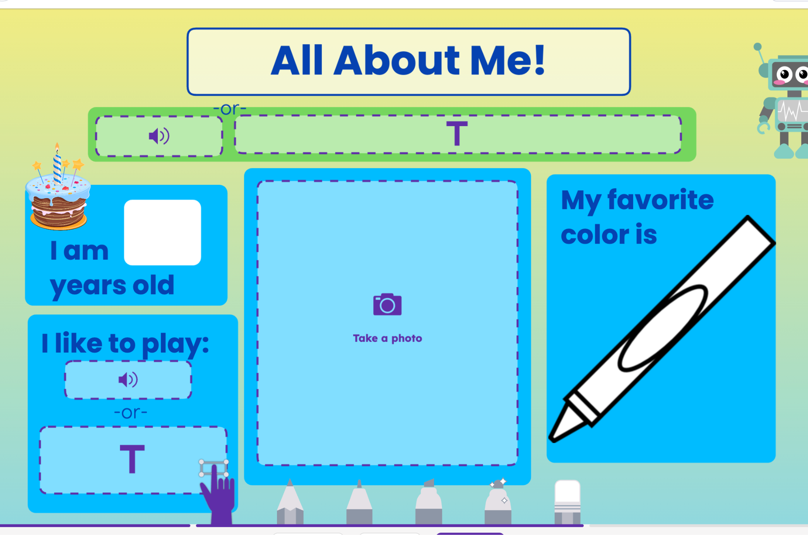
Year 2
Notes:
Seesaw

Slide 12
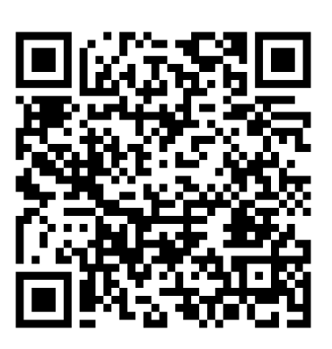
2S

Slide 13
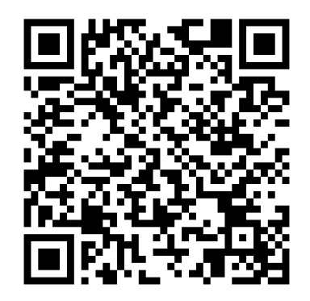
1M

Slide 14
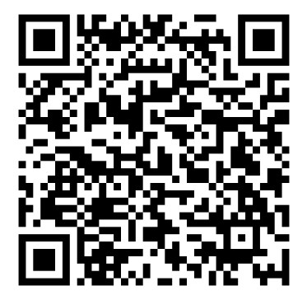
2v

Slide 15
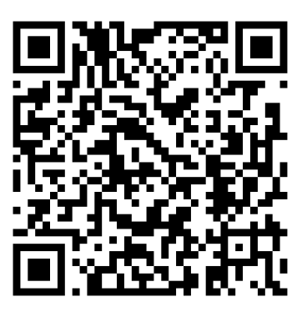
2I

Slide 16
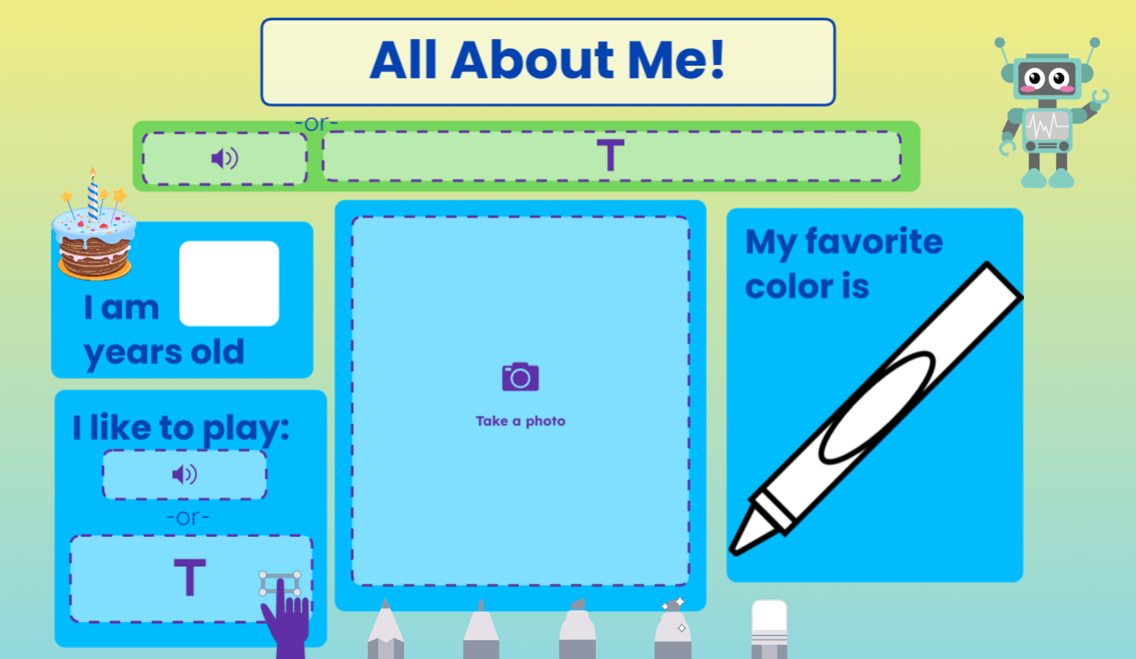
Year 2
Challenge:
Can you add an extra page to tell me more about yourself?

Slide 17
Now, how do I log out?

Slide 18
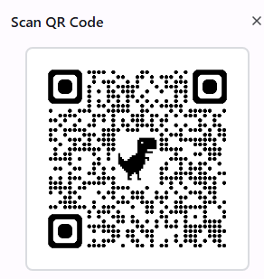
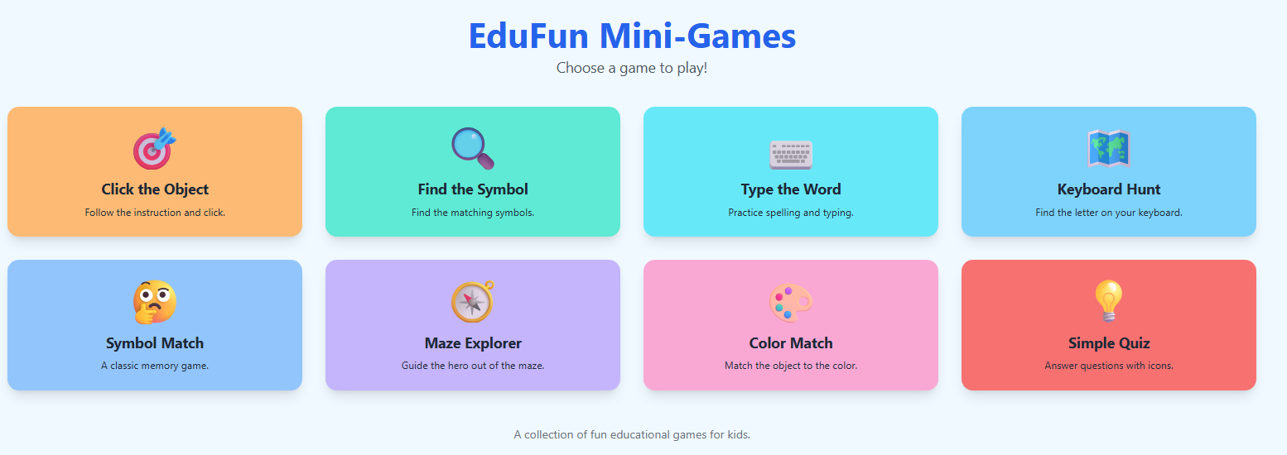
Mini Games Challenge

Slide 19
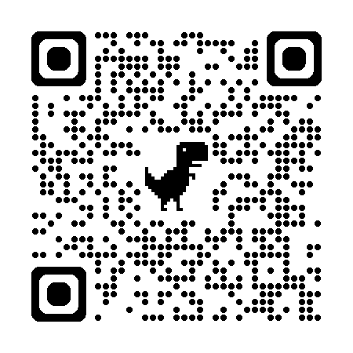
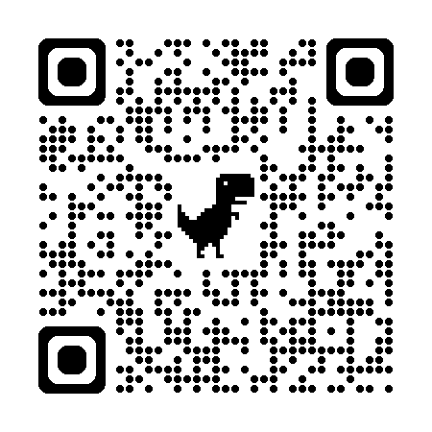
Word Wall Challenge Games

Slide 20
Welcome back to ICT!
2025
Lesson 2

Slide 21
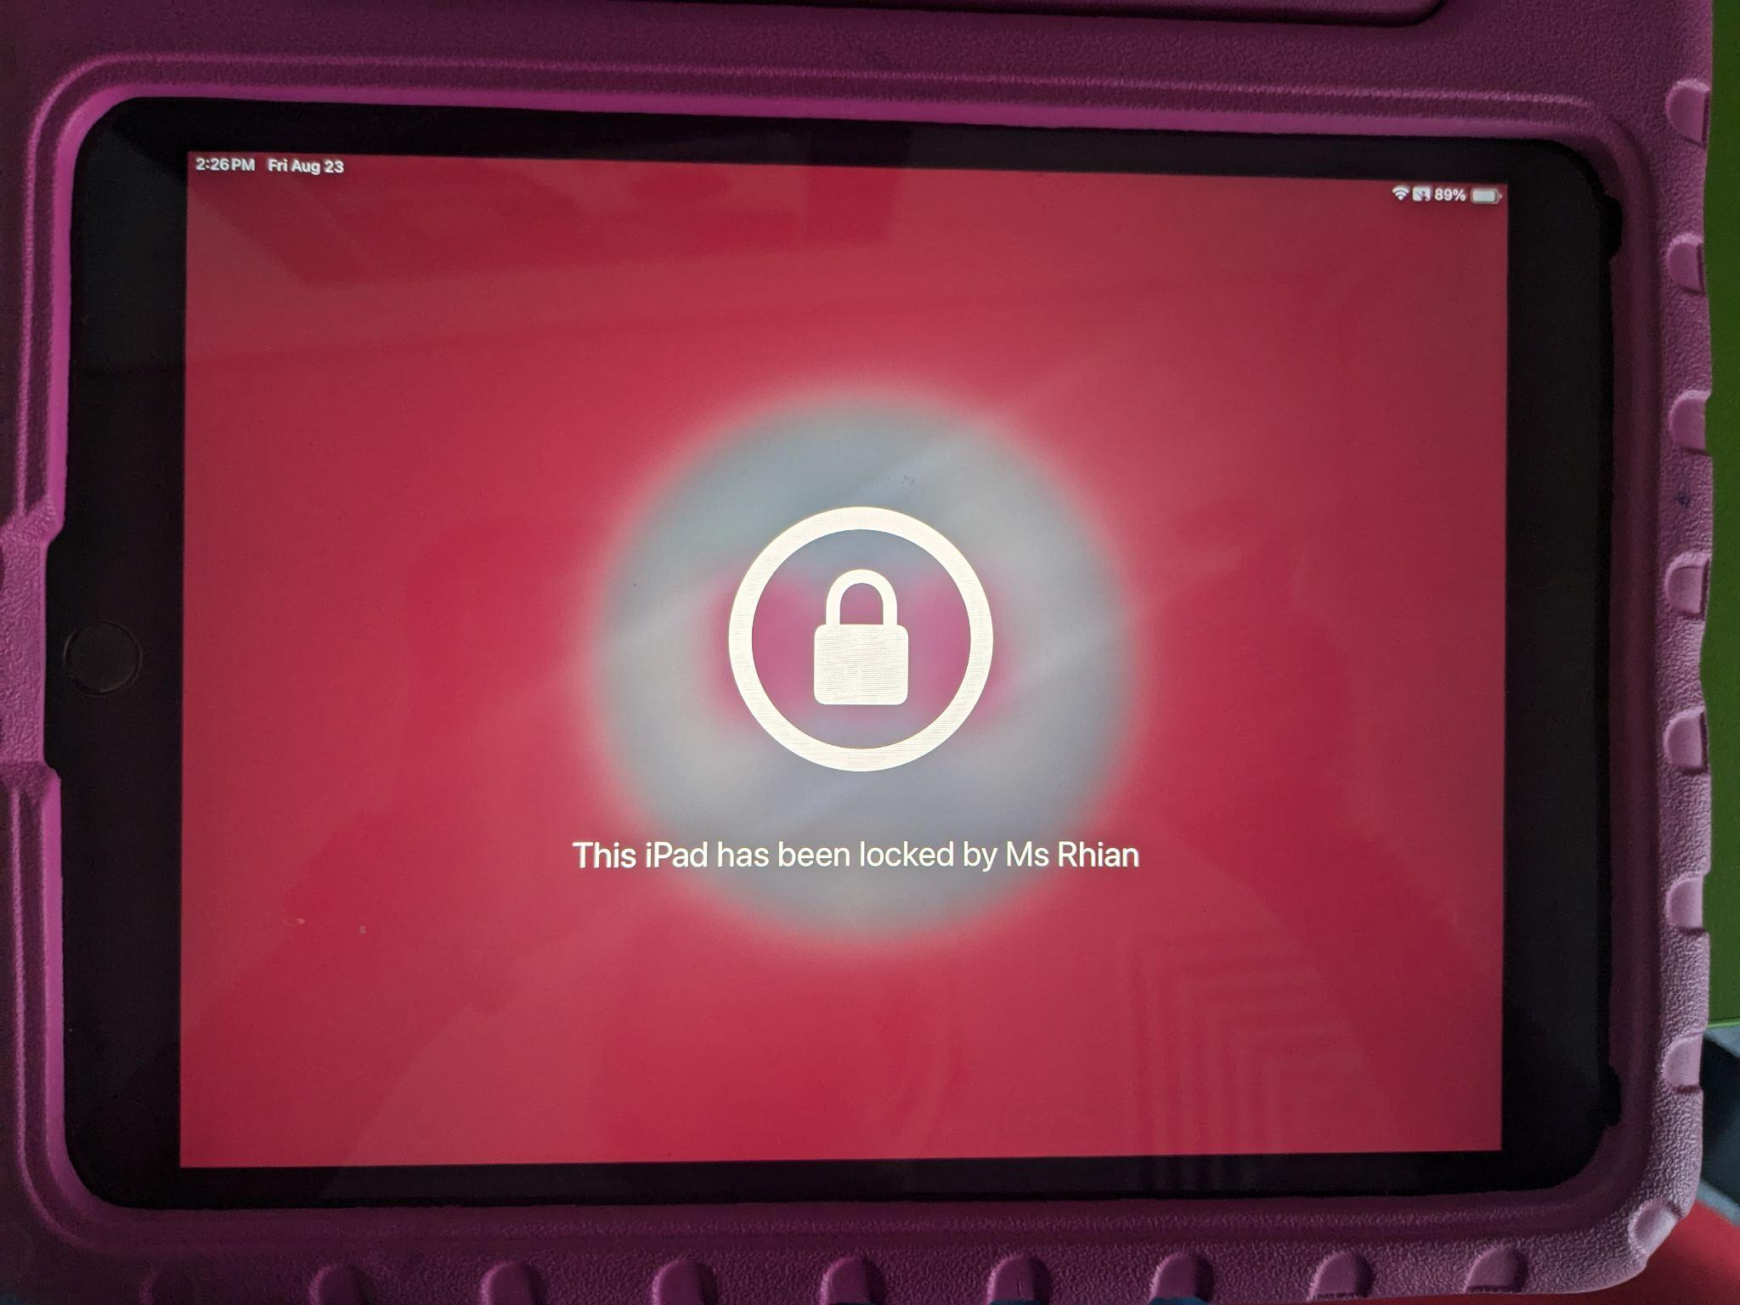

What should you do when you see this screen?

Slide 22
What do these look like in the DREAMS
Lab?

Slide 23
How many types of digital technology do you use every day?

Slide 24
What do we use this app for?
How do I login?

Slide 25
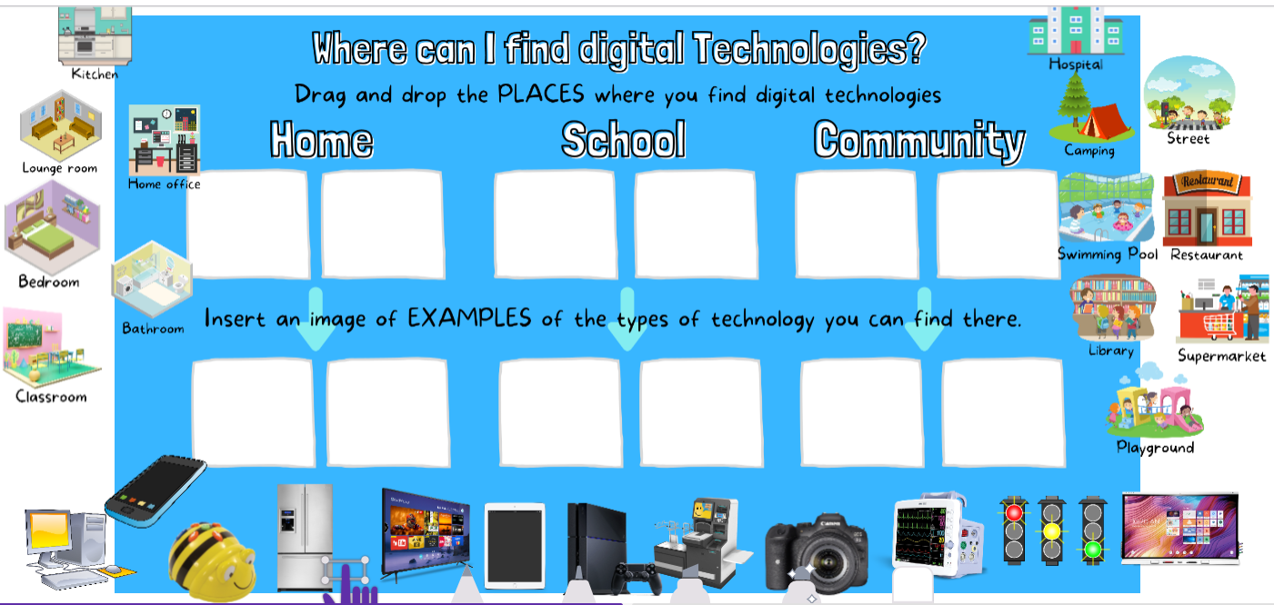
Y1 - Seesaw task
Notes:
Seesaw task

